Slide 1


Data quality workshop: getting it right – financial & regulatory metrics
Steve Smedley, Acuity

Slide 2

Agenda
1) Benchmarking basics – reminder
2) Sector metrics: how they relate (& a bit about VFM)
3) 4 key Acuity cost metrics
4) Regulatory metrics
Put away any sharp objects now

Slide 3
Benchmarking basics
benchmarking is the start of a journey not the last word
  biz analysis tool (internal) – explore variation, understand cost drivers
    evidence-based resource allocation & focused improvement work
    aim high - achieve ambition
    mitigate risks in challenging circs – create headroom/buffer
  transparency/accountability/political management tool (external & internal)
  provide assurance of sound grasp of cost and performance (ie VFM), in context, – a VFM regulatory requirement
Past Biz Plan Review Cycle Future
Benchmarking results
+ other quantitative & qualitative data
Decisions
Further investigation, priorities, resource allocation, improvement action
Implement
Evidence-based Biz Plans & VFM Strategy/Action Plans
Analysis
What’s the story?
How are we doing?
Insight
Understand strengths, weaknesses, priorities
Notes:
achieve ambition
deliver your corporate plan, create headroom
maximise social goals at the heart of your mission
mitigate risks – preserve value (& reputation) in the face of challenging operating environment, political/economic uncertainty, etc

Slide 4
Benchmarking basics
it is not ‘the answer’ or last word on VFM – ‘computer says no’
  limitation of metrics - data means nothing without the story of ‘why it is so’
    financial metrics often as much about context as performance
    cost & performance (inc quality & scope) in the round, complemented with other info
  …….so arguably judging your VFM is a very human, nuanced qualitative assessment
    taken in context of your mission & prevailing operating environment/circumstances
    considering available quantitative/qualitative data in the round
  not a finely calibrated tool for
    league tabling
    getting hung up on immaterial/minor apportionment
    exposing individuals
Notes:
It is
analytical biz tool to understand material cost & performance in context of your biz
where service scope, performance levels, operating environment (inc client group) & (in)efficiency are all cost drivers
high cost fine if investment is conscious decision, outcome is commensurate
enables considered human VFM judgements, options and robust decisions eg
target improvement action
target right allocation of resources
complements qualitative data: staff workshops/experience, TP/scrutiny, satisfaction, customer insight, complaints, stakeholder perception, service reviews, etc – to reach a rounded judgement
a transparency tool to demonstrate VFM to stakeholders
essential for non-commercial organisations (captured customers/monopolies)
a means of educating the ignorant about the extent of what you do ( ref Tory MPs!)
It is not
‘the answer’ or last word on VFM – ‘computer says no’
the data by itself means nothing without the story of ‘why it is so’
often as much about context as it is about performance, especially Global Accounts/RSH metrics
cost & performance, in the round, with other info, in context
a finely calibrated tool for
league tabling
getting hung up on immaterial/minor apportionment issues – they don’t change the headline
meant to expose individuals – requires supportive team response to collective/corporate issues

Slide 5
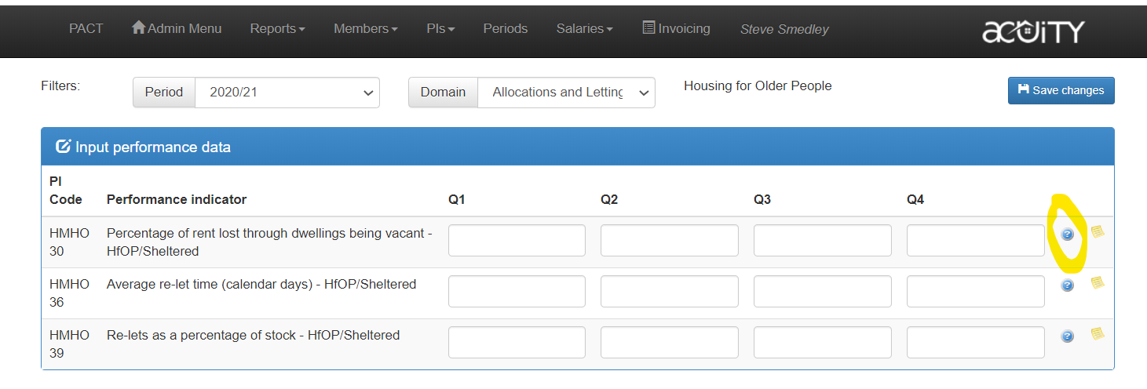
All definitions available on data entry page by clicking on the blue ‘?’
data quality is a hot issue for RSH
likely to go up agenda (White Paper transparency/accountability theme)
stick to the definition - might be different to how you traditionally count something
definitions can’t legislate for every eventuality – sometimes need interpreting – call us – clubs a useful forum to discuss this plus HouseMark crosscheck

Slide 6
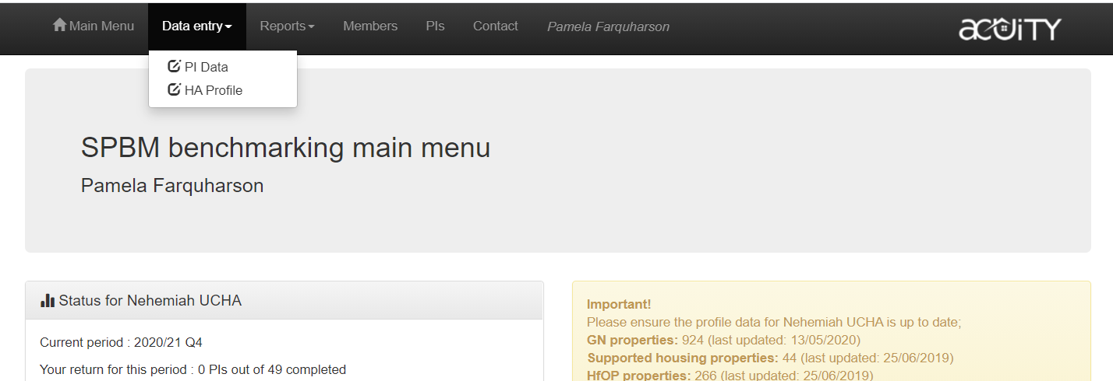
Benchmarking basics
when submitting end of year data, don’t forget to ensure your profile is up to date
‘profile’ page provides essential biz context eg GN, supported, HfOP stock #s, other forms of housing, turnover, staffing levels – useful when picking a bespoke peer group
Notes:
It is
analytical biz tool to understand material cost & performance in context of your biz
where service scope, performance levels, operating environment (inc client group) & (in)efficiency are all cost drivers
high cost fine if investment is conscious decision, outcome is commensurate
enables considered human VFM judgements, options and robust decisions eg
target improvement action
target right allocation of resources
complements qualitative data: staff workshops/experience, TP/scrutiny, satisfaction, customer insight, complaints, stakeholder perception, service reviews, etc – to reach a rounded judgement
a transparency tool to demonstrate VFM to stakeholders
essential for non-commercial organisations (captured customers/monopolies)
a means of educating the ignorant about the extent of what you do ( ref Tory MPs!)
It is not
‘the answer’ or last word on VFM – ‘computer says no’
the data by itself means nothing without the story of ‘why it is so’
often as much about context as it is about performance, especially Global Accounts/RSH metrics
cost & performance, in the round, with other info, in context
a finely calibrated tool for
league tabling
getting hung up on immaterial/minor apportionment issues – they don’t change the headline
meant to expose individuals – requires supportive team response to collective/corporate issues

Slide 7
Sector metrics: how they relate & a bit about VFM

Slide 8
Evidencing & Reporting VFM
Sector Scorecard
( voluntary benchmarking)
Notes:
This slide illustrates the role of metrics in demonstrating VFM

Slide 9
Evidencing & Reporting VFM
Regulatory requirements
( mandatory)
Sector Scorecard
( voluntary benchmarking)
HA’s strategic targets
Shared RSH/Scorecard metrics
Non-RSH Scorecard metrics
Er, so, what’s the question?......
Notes:
This slide illustrates the role of metrics in demonstrating VFM

Slide 10
Regulatory requirements
( mandatory)
Sector Scorecard
( voluntary)
Question:
Why are the headline metrics what they are ?
Is VFM being maximised?
HA’s strategic targets
Shared RSH/Scorecard metrics
Non-RSH Scorecard metrics
Analysis & Understanding
Get behind the headline metrics & explore context, variation, drivers
…. & where does Acuity fit?
Credible narrative & course of action: why the headline metrics are what they are & what you will do
Answer
Notes:
This slide illustrates the role of metrics in demonstrating VFM

Slide 11
Regulatory requirements
( mandatory)
Sector Scorecard
( voluntary)
Question:
Why are the headline metrics what they are ?
Is VFM being maximised?
Shared RSH/Scorecard metrics
Non-RSH Scorecard metrics
HA’s strategic targets
Analysis & Understanding
Drill down with Acuity cost & performance data, other cost analysis and qualitative data (eg tenant feedback, service reviews, etc)
Get behind the headline metrics & explore context, variation, drivers
RSH’s Regression analysis explains 50% of cost drivers
Credible narrative & course of action: why the headline metrics are what they are & what you will do
Answer
Notes:
This slide illustrates the role of metrics in demonstrating VFM

Slide 12

Where do 23ish consumer metrics leave the scorecard?

Slide 13
HA’s Strategic targets? – quick digression……..
Map your value to metrics, then set targets
your objectives/value
your metric/target
you
1) enjoyment of the home & community through excellent landlord services
2) new homes across a range of tenures
3) community investment – people, place & planet, improving quality of life, eg financial inclusion, employment, etc
4) support - dignity & independence
5) non-social? exists to support 1-4
Satisfaction 89%
increase in Rent, SO, Sell
# beneficiaries, £ invested, satisfaction, SROI/HACT measure?
# achieving indie living, distance travelled, support contract metrics, etc

Slide 14
How the various cost metrics relate - the detail!
Problem with RSH/accounts–based metrics:
headline SH CPU very high level (intended as can opener) – needs breaking down to be transparent….
but the headline’s components are flaky……weren’t developed for benchmarking! OK for accounts
accounting practice varies from HA to HA
you can stick your overheads where you like!
...or lose, say, high ‘Management’ costs by assigning x% as overheads & hide it in ‘Other’
you can decide what activity is ‘Management’ – v other lines eg
  client side repairs (‘maintenance’ or ‘management’)
  community development (‘management’ or ‘other’)……….etc
RSH’s Headline SH CPU
components:
  Management
  Service Charges
  Maintenance
  Major repairs
  Other
Acuity/HouseMark cost metrics (CPP)
Deceased accounts-based Acuity metrics
GNPI03 Av weekly cost per dwelling on mngmt
CPP01 Cost PP of Housing Management
Acuity RC Series
GNPI027 Weekly investment per unit
Response
CPP02 Cost PP of Responsive & voids
Reactive
Cyclical
Major works
Overheads (repairs)
Fees
Void works
Other repairs
Cyclical
CPP03 Cost PP of Major & Cyclical
?
Major
CPP04 Overheads

Slide 15
4 key Acuity cost metrics

Slide 16
About Acuity cost metrics
as noted, RSH/accounts-based cost components flaky for benchmarking
  need a method for allocating cost in a consistent way
driver?
  members identified need for robust but proportionate cost metrics (that fall short of the ‘full HouseMark’)
  regulatory expectation to explain costs (backed by evidence) & be transparent
comprehensive definitions, developed with HouseMark – compare to big HAs
  guidance doc explains all individually and as a suite – read it
commit to adhere to definitions – if not, don’t do them
  requires some effort but worth it

Slide 17
About Acuity cost metrics
4 metrics capture costs associated with common core biz of social landlord:
  1. housing management CPP
  2. responsive repairs & void works CPP (reactive maintenance)
  3. major works & cyclical CPP (planned maintenance)
  4. overheads as % turnover (also found in sector scorecard)
  housing management costs - differ markedly/justifiably depending on biz model (eg client group, flatted stock, extent of service offer, etc) – so exclude
    community investment/place shaping
    estate services (contractor side)
    care & support (inc support side of HfOP)
      therefore Support/HfOP provider should be able to compare to GN (unlike RSH metrics)
      caveat: apportionment of scheme staff between core housing management/support
    other service chargeable costs
  such costs are allocated to ‘other’ (effectively a 5th pot)
  remaining 3 metrics aren’t so narrowly defined:
    simply pick up costs of providing service
Notes:
support = intensive housing management = supporting people

Slide 18
Principle: split total operating costs into 5 pots
Housing Management
Responsive & Voids Works
Major Works & Cyclical
Overheads
Other
Rent Collection & Arrears (ex rent/service charge accounting)
Tenancy Management
Lettings
ASB
Resident Involvement
Estate services (client side)
All costs ref responsive & standard void works inc contractor & client side.
So staff taking repairs calls included as well as labour & materials.
All costs ref MW & cyclical inc Capital spend and contractor & client side.
So staff involved in programme management & stock included as well as works
Back office costs:
-Office premises
-Finance
-IT
-Central services inc HR, PR,front of house reception, Co. Sec, performance staff
CEO goes here
All costs related to:
-Estate services (contractor side)
-Support/Care
-Development
-Community investment
Plus reconciling items like depreciation

Slide 19
About Acuity cost metrics
with exception of capital spend in MW & Cyclical, all costs should = total operating costs (ie all costs should be allocated somewhere)
5th pot (other) - not benchmarkable due to differences in biz model, financing, mission and stock profile – so set aside
two principal cost types
  non-pay costs generally straightforward to allocate from your internal cost structure
  employee costs may be more difficult
    many staff at big HAs simply fall into one of the 5 pots
    but smaller HAs staff range across activities
    so, apportion based on time spent on respective activities
      roughly! Don’t agonise – material matters, marginal is irrelevant
Q. why is overheads expressed as % turnover and not per unit?
A. some biz models have significant activity that is divorced from unit #s managed but impact overhead costs, eg floating support, extensive community work

Slide 20
3 CPP metrics (& the Other pot)
  total direct costs of [activity] of managed stock
  # units in management
‘total direct costs of [activity]’
  ‘direct’ means excluding associated overhead (hence separate metric)
  total staff costs inc NI, pension & on-costs
  all non-pay costs
  exhaustive list types of staff & non-pay cost provided in definitions & guidance doc
don’t apportion CEO across activity – CEO is an overhead!
‘Other’ pot– remember, includes support/care, estate services (contractor) & community investment activity so that we may exclude them from CPPs.
Other ‘Other’ pot items include reconciling items
  one-off redundancy cost
  one-off pension deficit funding
  loan fees/financing arrangements
  charges for bad debt
  charitable donations
  depreciation of housing stock
  impairment
  cost of sales
  any other costs not part of ongoing operating expense

Slide 21
Overheads
  total cost of overheads x 100
  adjusted turnover
‘total costs ‘
  total staff costs inc NI, pension & on-costs
  all non-pay costs
  exhaustive list types of staff & non-pay cost provided in definitions & guidance doc eg
    CEO/PA, Corporate Services Directors & Corporate Support Officers
    Office Managers & Front of house receptionists (but not front of house customer service staff)
    IT
    Finance
    HR/Payroll
    Performance management & biz improvement
    PR/marketing
    Co. Sec/Corporate governance
  ditto non-pay eg office rents/depreciation, other premises costs (utilities, etc), office supplies, finance costs (audit fees etc), recruitment, training, IT hard & software, etc
‘adjusted turnover’ - required to avoid biz model skewing from property sales, diversification & in-house DLO
Notes:
A number of adjustments are required to ensure that turnover provides as consistent a measure as possible for benchmarking purposes. These adjustments include: excluding the turnover and costs relating to any business not managed by the entity being benchmarked (diversification), excluding any significant turnover relating to the sale of housing properties (HAs only) and excluding grant amortisation in line with FRS102. Adjusted turnover is therefore calculated from: 'Turnover' minus 'turnover not managed' minus 'turnover relating to the sale of properties' minus Grant Amortisation​

Slide 22
Regulatory metrics

Slide 23
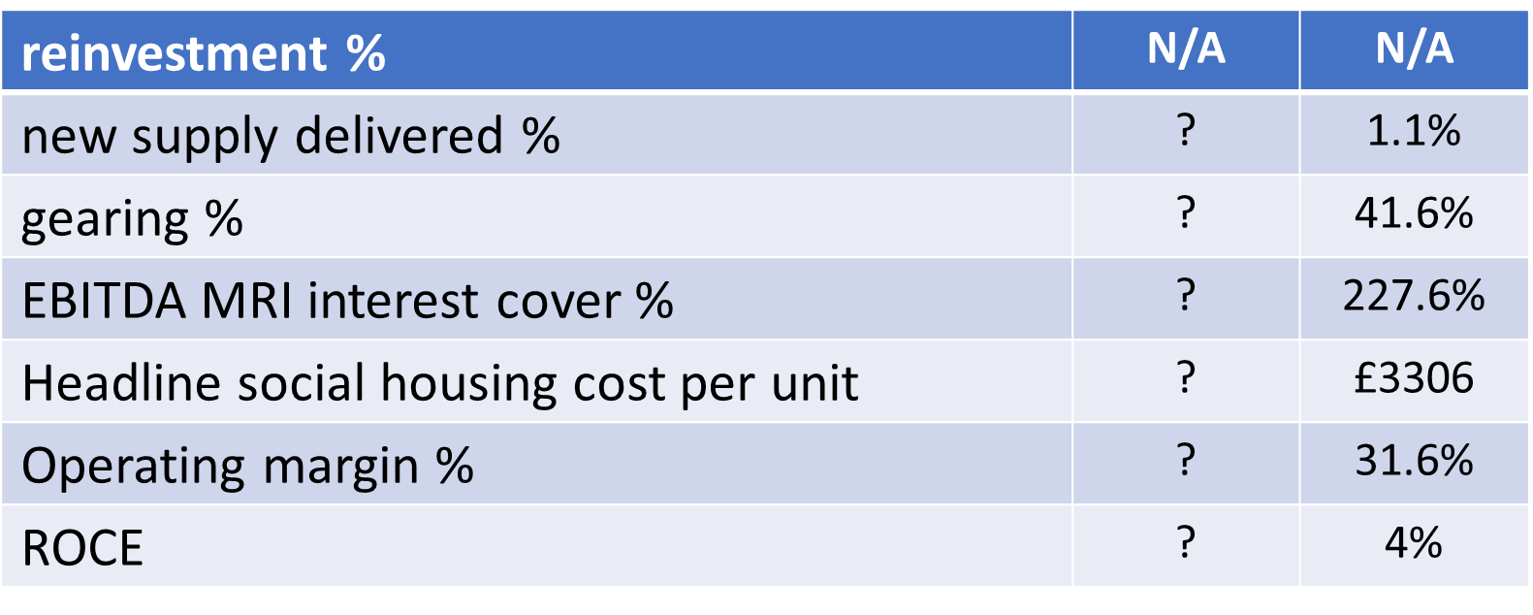
RSH metrics
represent different facets of value chain
RSH recognise no prescribed metrics can capture ‘what matters’ to all - hence use of HA’s own metrics
some metrics will expose certain HAs as outliers (especially smaller HAs)
  as much about context as performance?
  regression analysis isolates legit contextual cost drivers – appropriate peer group helps
how does RSH use them?
  starting point not the end - not a league table – looked at in round, intelligently, in context
  drawn to outliers
  why is it so? – basis for story
    written test (reporting in accounts); verbal test (IDA)
  current RSH VFM focus - how sector squares investment circle with finite resources
    realistically means a shift from development to existing stock
Notes:
The RSH metrics are simply one half of the requirement. They are not more important than your own corporate metrics/targets. The latter should map to your mission and help you articulate as well as quantify the value you exist to create.
The RSH metrics are as much to do with context as performance. The RSH understands this and is not looking for a specific result. Rather the metrics are a starting point to look at your understanding of ‘why it is so’ and the rationale for you adopting a specific position, eg margin of X, interest cover Y and gearing Z. It is not about league-tabling but instead looking at the metrics in the round, in context and being assured by your understanding of the position and the robustness of the decision-making that underpins your stance about where you should be with each of the metrics. In this way the metrics are simply being used as a tool to question and think about the best use of resources in pursuit of your mission! Eg an organisation that deliberately holds down rents is likely to have a lower margin. That is great VFM if the objective is tenant affordability or terrible VFM if the objective is supply. You best understand your context and mission which is why RSH is letting you make the judgement.

Slide 24
Getting the calculations right
metrics definitions - components correspond to lines in the electronic accounts ie FVA template (NROSH)
‘VFM metrics: tech note guidance May 2022???’ (updated as & when)
  provide full definitions of metrics (also on Acuity system)
  map definition components to specific lines in the accounts
    large HAs – map direct to the FVA template (should be idiot-proof!?@) – annex A
    small HAs – generally don’t do FVA so trickier hence annex B which is
      intended to help small providers locate the equivalent lines …..within their statutory accounts and enable them to calculate the VfM metrics
RSH imagined that as you are required to report metrics in stat accounts, auditors would have a hand in ‘validating’ your data
in other words, your auditor should know how to get this right & assist!

Slide 25
TSM timetable
Spring – Summer 22 | RSH analyses feedback from consultation
Late Summer 22 | RSH publishes decision statement, TSMs and technical guidance in anticipation of1 April 2023 implementation date. (Acuity plans to incorporate metrics so that members can pilot TSMs 2022-23 if they wish)
Autumn 22 -Spring 23 | Providers prepare systems
April 2023 - March 2024 | Providers collect first year of data
Summer 2024 | Providers submit data to regulator
Autumn 2024 | RSH publishes 2023-24 provider data

Slide 26
Get in touch about any further issues
steve.smedley@arap.co.uk
07814 424426

