Slide 1
Acuity Webinar
Managing risk: what good looks like
in 2022
Sam McGrady, Director
26 April 2022

Slide 2
Content of session
Brief introduction to DTP and myself
Context
Operating environment, regulation, governance
Sector Risk Profile 2021
Risk registers
Assurance mapping
Risk appetite
Linking risk to decision making
Roles and responsibilities
Q&A

Slide 3
About DTP:
Established in 2006, DTP is an independent consultancy providing high quality advice and support to affordable housing providers, charities and commercial organisations across the UK
Our mission is to help businesses improve and deliver better services to their residents
Core team of 14; specialist associates

Slide 5
About me:
Director at DTP for 6 years
Previously HouseMark, interim management and in the early days, housing management
Specialise in regulatory compliance, governance, risk, VFM, strategy development
Sit on Regulator of Social Housing (RSH)’s Advisers’ Panel
Member of CIH Policy Advisory Committee
Notes:
Explain Cosmopolitan

Slide 6
Context - a sense of urgency
Risk management should be at the top of board agenda right now - Covid-19, Grenfell, post-Brexit impacts, war in Europe, supply chains, economic concerns, regulatory focus
But also because of nature of the sector – diversification, pressure to develop, building safety/asset investment, net zero carbon – all bring new and heightened risks
Reputational risk – often overlooked
Boards should be on top of this – it’s a key element of good governance
Board needs good information and reporting from officers
Risk management needs to be embedded
Risk appetite needs to be understood and used

Slide 7
Context – wider operating environment
Economic situation – inflation, cost of living crisis, energy costs, tax increases, supply chains…..
Covid continues to impact – staff sickness, job vacancies, vulnerable people….
War in Ukraine – impact on prices and supplies
Brexit impact…..really hitting home now; imports/exports and supply chain issues
Economic growth predictions reduced
Inflation 6.2% - potential peak 8-11% this year
Significant job vacancies and fall in real wages
Huge hike in house prices and private rents

Slide 8
Context – housing
Levelling up – what does it mean? Will anything change?
Tenants badly impacted by cost of living issues
Increases in homelessness as Covid provisions end
Cyber management – resource increases due
to new standards/regulation, increased threat etc.
‘Strategic choices’ – how much of your finite pot of money do you spend on new homes, existing homes, services to residents, community investment?
Ongoing pressure to build new homes – funding, costs etc
Huge future financial investment needed in existing stock (building/fire safety, net zero carbon)
More to follow……

Slide 9
Context - regulation

Slide 10
Regulation (Standard)

Slide 11
Regulation (Standard)

Slide 12
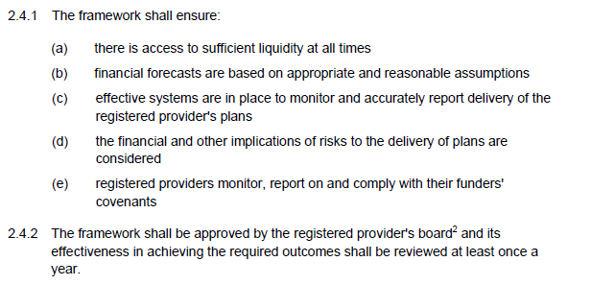
Regulation (Standard)

Slide 13
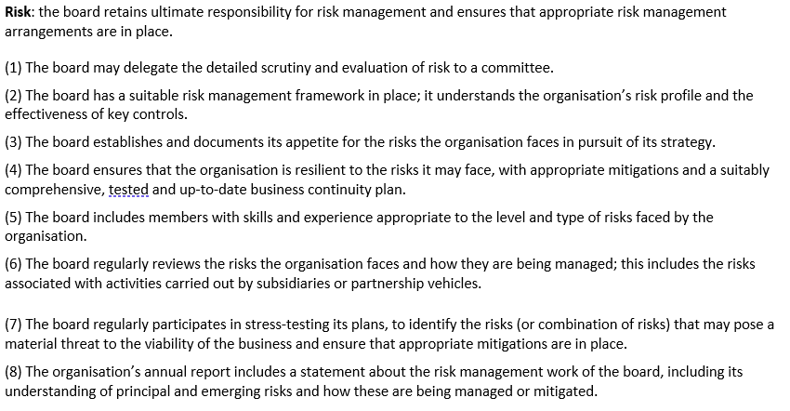
NHF Code of Governance 2020
Principle 4 – Control and assurance
Section 4.3 Risk

Slide 14
NHF Code of Governance 2020
Principle 3 – Board Effectiveness
Section 3.1 Functions of the board

Slide 15
RSH
Sector Risk Profile 2021
Strategic Risks
Diversification | Access to labour and skills
Delivering against expectations (aka reputational risk) | Counter-party risk
Value for money
Operational Risks – existing stock and service delivery
Existing stock quality | Delivering services to tenants
Health and safety | Supported housing
Costs and inflation | Rent setting
Rental income and arrears | Data integrity
Data security

Slide 16
RSH (England)
Sector Risk Profile 2021
Operational Risks – Development (unchanged)
Low cost home ownership and market sales | Construction process risks
Finance and treasury management (unchanged)
Existing debt | New debt
Alternative funding models | Pensions
Fraud

Slide 17
Risk registers
Strategic risk register – directly linked to corporate plan
What are the key risks to delivery of your purpose and corporate objectives?
Take Sector Risk Profile as starting point but bespoke to you and your business
Keep it high level – absolutely the top risks
Operational risk register(s) can sit below
Risks can move between the two
Project risk registers
Evaluate and score risks – gross, residual and target (links to appetite)
Mitigations and controls
Regular update reporting to board (and Audit Committee)

Slide 18
Risk register examples

Slide 19
Assurance mapping
Three lines of defence:
Risk control: internal controls and business operations
Objectives, policies and procedures
Risk management: executive management assurance
Capable and competent staff
Reporting and compliance functions
Financial, risk and performance management
Feedback
Risk assurance: independent assurance
Internal audit
External audit
Consultant reports and inspections

Slide 20
Risk appetite – what good looks like
Appetite for risk against each strategic risk/risk groups
Averse, Cautious, Balanced, Open, Hungry
Supporting narrative against each to explain appetite
Can simply define current appetite, or take a more nuanced approach which includes direction of travel….
Some organisations set a tolerance also (though this isn’t common in the sector)
Early warning triggers – thresholds, targets, limits
Board must approve
Used to inform decision-making
Future-proof it – enable an agile culture
Don’t over-complicate it! No different to your appetite for risk in other walks of life

Slide 21
Standard sector approach
Category | Averse | Minimal | Cautious | Open | Hungry
Health & safety
Condition of homes
Building new homes
Customer service
Financial health
Technological
Legal compliance
Regulatory compliance
Values, mission and culture

Slide 22
Use it!
Overarching strategic vision – what do you want to be and how much risk are you prepared to tolerate?
Making decisions – does what’s being asked of you/recommended sit within stated risk appetite?
If not, is it the wrong decision? Or the wrong risk appetite?
Board papers for decision should include risk appetite – tolerance and target
Seek assurance from executive
Challenge each other, ask the right questions – easy to get ‘carried away’
Can also be used in T&FGs to guide activity
Executive should be mindful of it when preparing board papers and when taking delegated decisions

Slide 23
Linking risk management to decision-making
Board papers for decision should have a risk implications/impact section
Must be completed and be clear:
what the risks are in the decision
where these risks feature in the risk register
what area of the strategic plan the risks link to
where the impact of the risks in the decision lies within the organisation
Risk appetite must be referenced – where does the decision lie in terms of your appetite in the given area?
Board should discuss the risks, understand their implication, consider trade-offs, and accept inherent risks prior to making a decision
Risk assessment can equally be used to decide NOT to do something

Slide 24
Role of the Board
Must lead on risk management
Is ultimately responsible
Should be identifying new risks, challenging existing risks
Must understand where impact of each risk lies within the organisation
Must seek assurance on effective risk management from (Audit Committee and) staff
Should identify its risk appetite and then use it
Must receive regular updates on risk register
Risk should be a standard agenda item for each meeting

Slide 25
Role of the Audit Committee
Independent adviser to the board
Understands where to skim, question or dig deep
Steers executive but doesn’t do their jobs
Focuses on key risks
Ensures risks are fully reflected in annual internal audit plan
Undertakes or commissions additional detailed work on risk where necessary
Commissions / uses external audit to test and validate risk management and controls
Adds value to the Board’s work on risk (but ultimately Board is responsible)

Slide 26
Role of the Senior Team
Identify new and emerging risks
Standing agenda item at each meeting
Review the strategic risk register and update quarterly
Ensure strategic risk register is brought to Board regularly
Provide assurance to Board that risk is being managed
Embed a culture of risk management throughout the staff, and make risk management a key aspect of the performance management framework

Slide 27
Q&A

