Slide 1
Regulation: where are we going?
Acuity Conference- 19 April 2018

Slide 2
Outline
Shape of the (changing) sector
Regulation – on-going and evolving:
Sector risk profile
Rent regulation
Consumer regulation
VfM standard
Providers

Slide 3
Recent movements
£2bn funding including social rent
Rent certainty from 2020
Removal of LHA caps (consultation on other approaches)
De-regulation
Local authority influence regulations
ONS classification
Accompanied by an ask…
Notes:
Government action/sector reaction?
Priorities aligned?

Slide 4
Forthcoming
Grenfell fire
Technical
Tenant voice
Complaints
Stigmatisation, challenging stereotypes
…?

Slide 5
Regulation
Ensure we have appropriate understanding of sector level risks
Deliver intelligence led regulation
Ensure we are forward thinking and responsive to changes in the external operating environment
Ensure we are an efficient and effective organisation
Effective regulation
Responsive to increasing diversity, changes in risk profiles
Make best use of resources – level of engagement/sufficient assurance
Introduction of fees
Move to stand alone – Regulator of Social Housing

Slide 6
Sector Risk Profile
Health and Safety (see also Consumer Regulation Review)
Investment in existing stock
Rental Income
UC roll out
Supported housing
Funding
Health and Safety and Care requirements
Economic Risks
Benign economic environment – low interest rates, and house prices
Robust stress testing
Development Risk
Increase in market sale and shared ownership
Income from sales receipts > income from grant or debt
Debt - £24bn forecast over 5 years
Interest rates

Slide 7
Rents
Rents is a matter on which the SoS can direct us and did so prior to the Welfare Reform and Work Act 2016
New Rent Direction to implement the new policy of CPI+1% from 2020
MHCLG consultation on direction, RSH consultation on standard
New standard with effect from April 2020
Supported housing consultation closed on 23 Jan – proposed
sheltered and extra care rents would be regulated by RSH
long term supported housing funded through the welfare system
short term supported housing ring-fenced grant to LA to allocate

Slide 8
Consumer regulation
The current position:
Materiality & proportionality – regulator focuses on systemic issues
Our role is reactive
The regulator may only act:
where there has been a breach of a standard
which has, or may, cause serious detriment (serious harm) to tenants or potential tenants
Regulatory Notices and impacts on governance judgements
A strong grip on compliance is a fundamental board responsibility – response post-Grenfell
The importance of effective internal controls and board oversight
Where a problem comes to light, it is essential that effective action is taken
Transparency with the regulator is essential if a provider suspects a breach
Role of board – regulation a backstop

Slide 9
Value for Money Standard changes
New standard, Code of Practice, suite of standard metrics enforced since 1 April 2018
Providers’ own strategic objectives; articulate strategy for delivering homes that meet a range of needs; and Board agreed approach to achieving value for money
Set own metrics and report against
Defined set of metrics – transparency

Slide 10
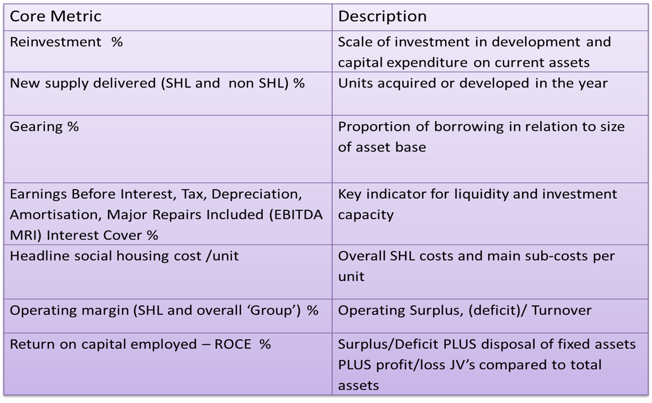
Metrics

Slide 11
(De)-regulation
Removal of consents regime
Disposals of tenanted stock
Strengthen TI&E standard – consultation with residents
Reaction of stakeholders – reputation
Trading regulatory risk for political risk

Slide 12
Providers
Board own strategic priorities/objectives for organisation – existing stock, new supply, services, community
Ensure robust risk management and stress testing – triggers and mitigations
Assurance re controls and iron grip on compliance - health and safety
Certify compliance annually with G&FV standard
Co-regulatory settlement
Reputation – individual and sector
Political (local, national)
Existing stock/tenants, new supply/future tenants, service delivery and standards, handling complaints, engagement and communication, payoffs, remuneration, efficiency, value for money
Good governance

Slide 13
Regulation of smaller providers
Regulating the Standards updated April 2018 – sets out approach
All standards applicable
BUT proportionate approach to the c1200 smaller providers
Review of financial statements
Analyse Statistical Data Return
Review notifications about disposals and constitutional changes

Slide 14
When we may seek to engage further – Assurance sought
Viability issues
Growth / New business area
Reactive - Allegations
Business plans and forecasts including VFM
Stress testing and scenario analysis – linked to risks faced
Development risk identified and managed
Clear rationale – including VFM
Provider response – transparent, independent

Slide 15
Last 6 months – common problems that have emerged more than once
Non-social housing activity – loss making/contracts lost
Covenant monitoring – including non-financial
Development overruns
Gas/fire safety matters
BUT context of a small proportion – c30 providers.

