Slide 2
Acuity SPBM conference
Communications – How to Tell Your Story
19 April 2018

Slide 3
Who are you?
And who do you want to reach?

Slide 4
Know who you are and establish your presence
Be visible, establish and reinforce your brand in the minds of your audiences.
  Who are you?
  What is your mission?
  What are your values?
  What is your vision?

Slide 5
Research and preparation
Get the deskwork done early.
Planning is essential to success
Research
Invest early in professional guidance – take specialist advice
Review and update corporate ID and brand guidelines
Get media trained

Slide 6
Who do you want to reach?
Use your research findings to identify your target audiences
Segment your audiences
Define your stakeholder groups
Employees/volunteers as stakeholders and ambassadors
Decide which influencers you want to engage
Be realistic – don’t try to reach everybody on a limited budget

Slide 7
Targeting
Precise targeting has never been easier
  Understand your target audiences and stakeholders
  Understand the demographics
  Know what media they use
  Know who they are influenced by
  What are their activities, hobbies, groups, associations?

Slide 8
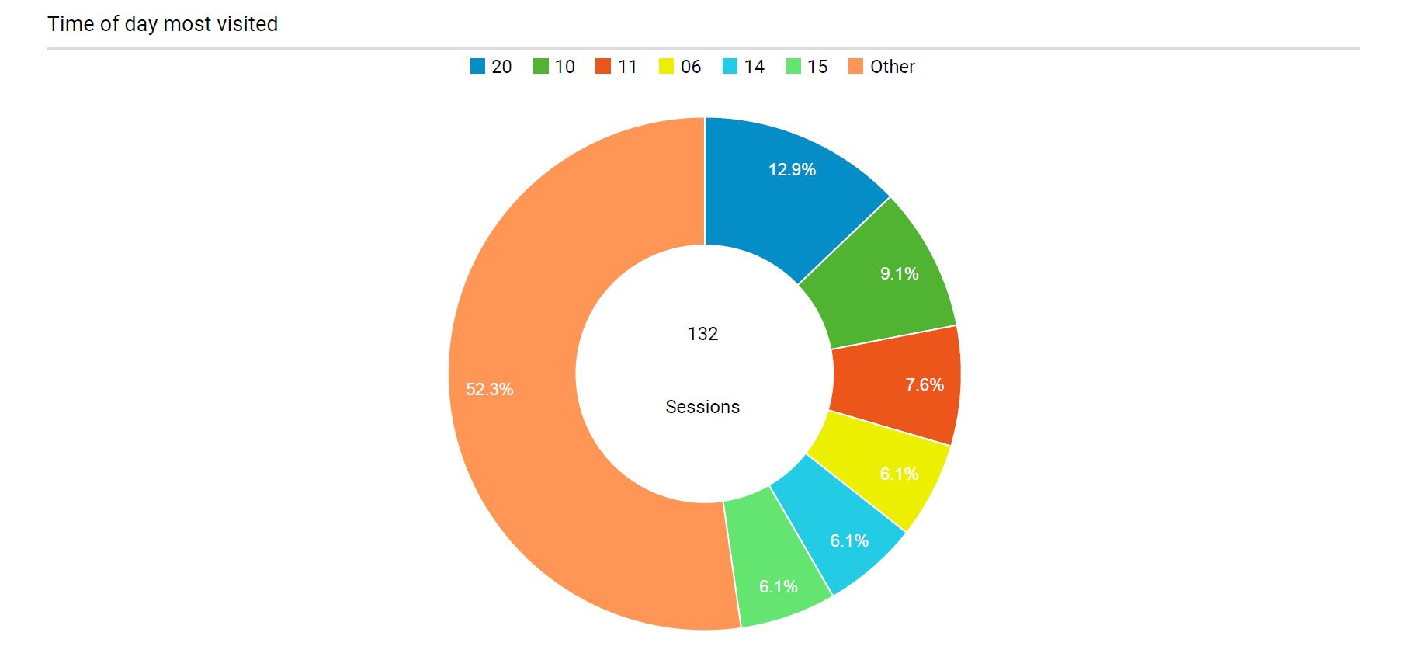
Analytics – essential to targeting

Slide 9
Your story
What to say and how to say it

Slide 10
The golden thread
Your story must have depth and authenticity. Instill and nurture a shared sense of purpose throughout your organisation.
Reflect your mission, values and vision in everything you do.
Lead by conspicuous example
Inspire
Engage with your internal audiences
Not an HR responsibility – a communications and leadership issue
A strong culture mitigates reputational risk and adds value

Slide 11

Epitomise your brand

Slide 12

Be positive about your brand

Slide 13
Don’t let others decide who you are
Control your corporate narrative – write your own story.
Messaging should:
Be planned and proactive
Reinforce values, mission and vision
Be coordinated and consistent
Be tailored for multiple platforms and channels
Be distinctive

Slide 14
Tell an engaging story - be interesting!
Engage with your audiences
Make the story directly relevant to each particular audience
Be interesting
Be innovative
Use strong content
Continuously reinforcing values, mission and vision
Develop the story over time

Slide 15
The immediacy and reach of online
  Use original words and content
  Tailor to specific stakeholder groups/audiences
  Use audience-specific platforms/channels
  Use appropriate language
  Content is king – use photography, illustrations, infographics, audio, video

Slide 16













Network your online and social media presence
Blog
Webinars
LinkedIn
Facebook
YouTube
Twitter
Stakeholder, influencer and target audience database GDPR compliant
Tracking and analytics
Podcast
Livestream
Publications
Apps
© Ah! Hillier Consulting 2018
Partner websites

Slide 17
Include print and broadcast media
  Remember ‘traditional’ media
  Forge relationships
  Get trained – not for amateurs
  Supply newsworthy stories
  Offer properly crafted copy
  Provide great photography
  Work to media deadlines, not yours

Slide 18
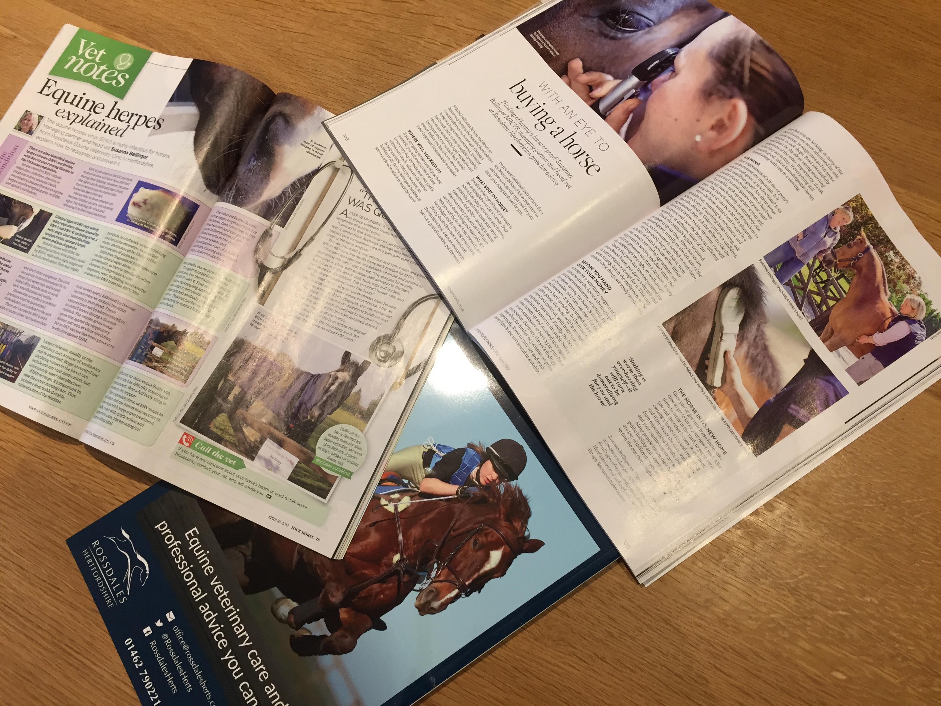
Keeping print media in the mix

Slide 19

Embrace broadcast media

Slide 20
Detail does matter – get it right!
The message and big picture are compromised when detail is overlooked.
  Don’t use clip-art
  Use good quality, hi-res photography
  Adhere to the brand manual guidelines
  Don’t ‘delegate’ communications to the enthusiastic amateur

Slide 21
Be professional
No ‘homespun’ or ‘on-a-shoestring’ excuses.
Slapdash newsletters, website, posters, advertising, PR:
  Lack credibility - reflects poorly on management team
  Undermine excellence elsewhere in the organisation
  Will be overshadowed by other, more professional organisations
  Give a poor impression to funders and benefactors as well as residents and staff

Slide 22
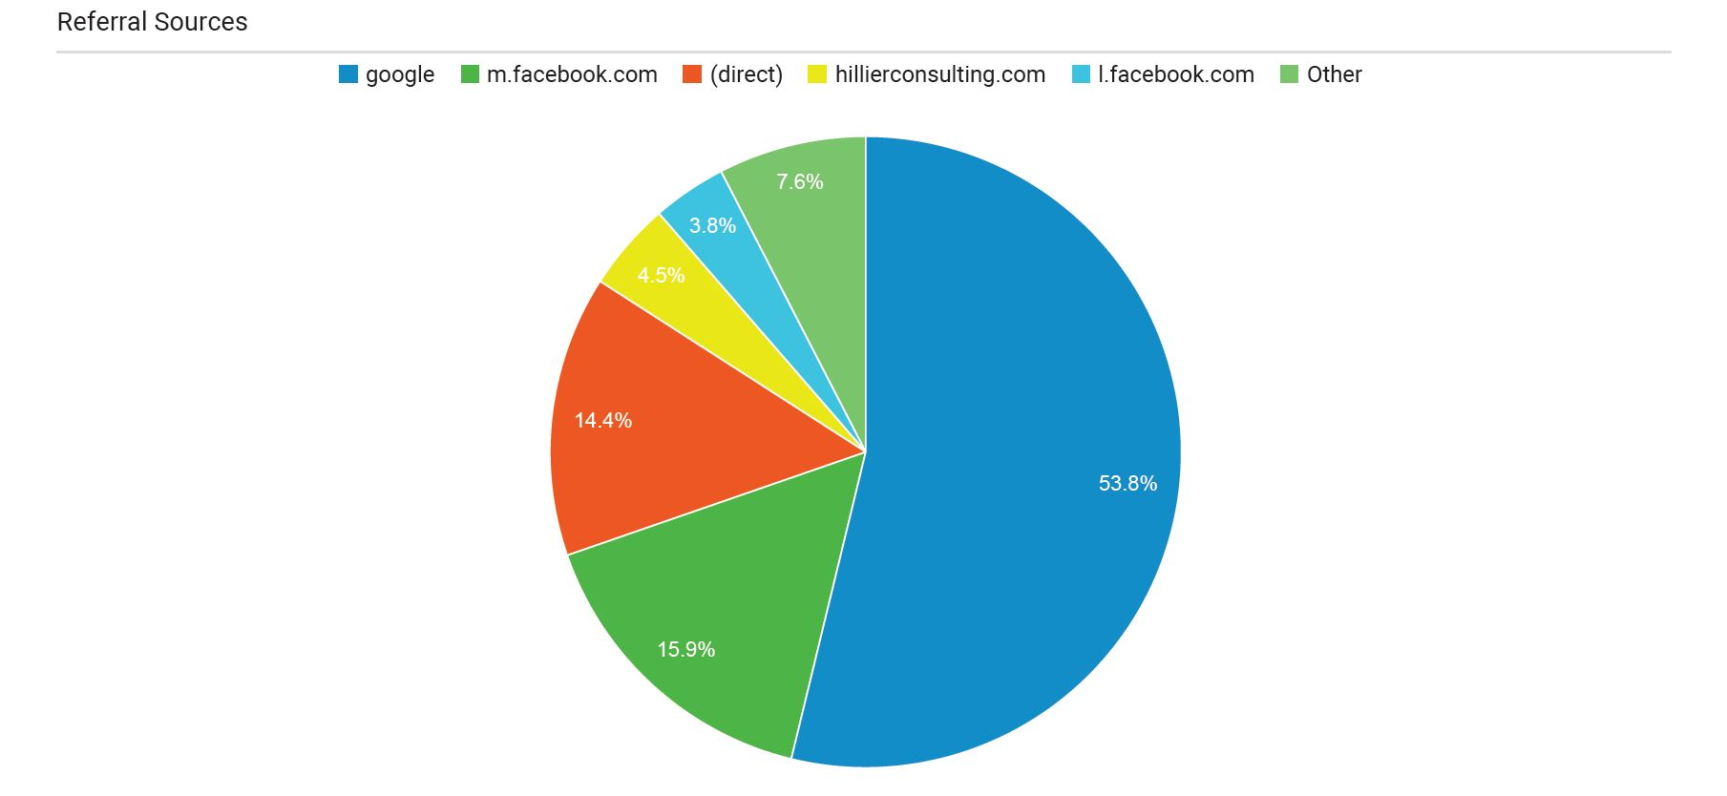
Research again - track your engagement

Slide 23
And when there is a crisis
Don’t add fuel to the flames

Slide 24





BP – Deepwater Horizon

Slide 25
Crisis management communications
Deepwater Horizon was an environmental catastrophe, probably the worst such disaster the US has experienced
As if things weren’t bad enough – BP’s leadership was:
  Ill prepared and ill advised
  Perceived as arrogant and uncaring
  Seen to be concerned solely with the financials
  Poor communications undermined brand values and reputation

Slide 26

Don’t let a crisis become a drama

Slide 27
Crisis communications
  Take professional advice and prepare to be challenged
  Have a plan and test it
  Update the plan on a regular basis

Slide 28
Crisis communications
Managed
Proactive
Planned - with flexibility for rapid response
An opportunity to reinforce values and vision
Everybody in the loop – trustees, employees, residents, stakeholders
Consistent

Slide 29
Contamination
Should a housing provider be perceived to be acting disreputably, the whole sector is tainted by association.
Bad news travels fast
Bad news makes good headlines
And the subsequent damage to brand and reputation can be terminal

Slide 30

Crisis management – not a band-aid for bad management

Slide 31
Good works undermined

Slide 32
Invest in story telling
Be professional
Bring it into the boardroom
Mainstream it
Unlock its power
Research, review, refine
Reap the rewards

