Slide 1

Developing Homes
Challenges faced by small housing associations in London

Slide 2
Who are the g320?
With 67 members, we provide a combined 19,000+ units of accommodation
Our members have less than a 1000 units and we all operate in London, all are RPs and are members of the NHF
We run a benchmarking club with Acuity, the bm320
The g320 holds quarterly meetings which provide an opportunity to learn from each other, collaborate and develop new ideas
Regular Speakers include the GLA, TPAS, Homeless Link and the NHF
We share best practice, policies and some of us share staff or procure together
We are a varied group, with some general needs, sheltered, specialised and self build housing providers. A number of cooperatives and community led housing providers are members

Slide 4
What do we achieve?
We release a bi-annual impact statement which tells the stories of how we house and support our tenants, how we build homes and what we gain from collaborating
We have our own Acuity benchmarking group who while benchmarking also collaborate on shared projects
Acuity benchmarking shows that our members were bucking the London trend in Tenant satisfaction, achieving top quartile in every General needs and Older persons category
We respond to national consultations such as the HCA’s consultations on Value for Money and fees.

Slide 5


Is merger a way to increase development capacity?
Where the sum of our parts is greater together, we will collaborate. There has been a handful of mergers between members
Crown Simmonds:
  A merger in 2014 between Rosemary Simmons Memorial HA and Crown HA with 791 properties
  Merger was designed to protect both financial positions, managing risk while increasing both impact and influence and attracting the best staff
  The capacity is there to deliver 150 homes in the next 5 years
Harrow Churches HA:
  Has merged in 3 HAs, Harlington Rectory HA in 2015 adding 54 homes to HCHA’s portfolio, and Stanmore Christian HA. Stock has also been transferred in from Thames Valley HA

Slide 6
Developing more homes
g320 worked with Altair late 2017 to understand how members are developing more homes
The survey covered 39 or 58% of our members, who manage 19000 units
These members developed a combined 176 new homes over 2016/17 which was due to double to 373 over 2017/18 – 2% of stock
90% of the current development programmes are for social rent, with 60% of members funding this from existing resources, GLA grant, Right to buy receipts and capital raised from asset disposals
24% of members do not have a development pipeline at the moment but aspire to become developers
Two thirds of those surveyed would sign up to a g320 development pledge
All of those surveyed had at least one board member with development expertise, however over 80% did not have an in-house development team and resource this expertise externally from consultants such as Altair and Red Loft

Slide 7
Developing more homes
Respondents were generally not confident on managing market sale or shared ownership development, nor were they confident liaising with planning
The barriers to development are many, including:
  Funding where members are close to borrowing limits, financial constraints
  Lack of risk appetite and
  The cost of and access to land
  Competing strategic priorities
  Being too small to win opportunities
  Lack of local authority support and guidance
To overcome some of these barriers we will consider a “how to” guide to development focused on small HAs, sharing development expertise through a shared development advisor, sharing procurement, partnering with larger providers and developing a g320 housing pledge
The policy environment is encouraging with the Mayor’s London Housing strategy actively encouraging small HAs to develop, and the GLA launching their Small Sites Initiative

Slide 8
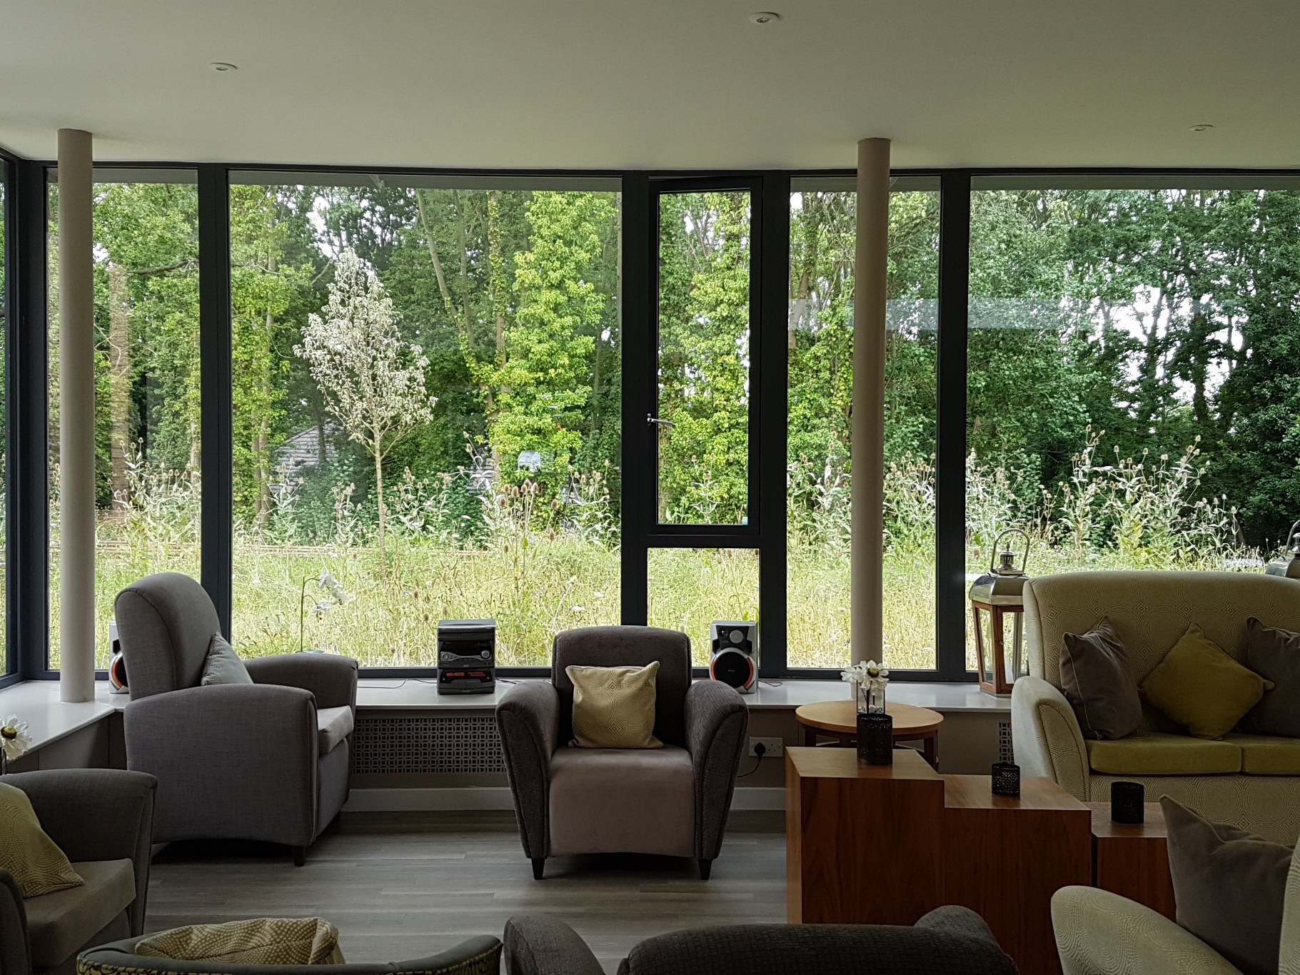


Slide 9
Harrow Churches HA
With 425 units, HCHA develops as a member of the West London Connected development Partnership
Partnerships include:
  Extra care flagship 76 home scheme developed with Octavia
  Partnering with a local church 28 life time homes were developed
  Rent to buy scheme with Rentplus in Oxfordshire opened in 2017
  Department of Health capital funding to develop 30 homes
HCHA’s social mission is to provide more homes when and if they can. They know they can do more in partnership with others and are not afraid to look for new opportunities and funding routes

Slide 10
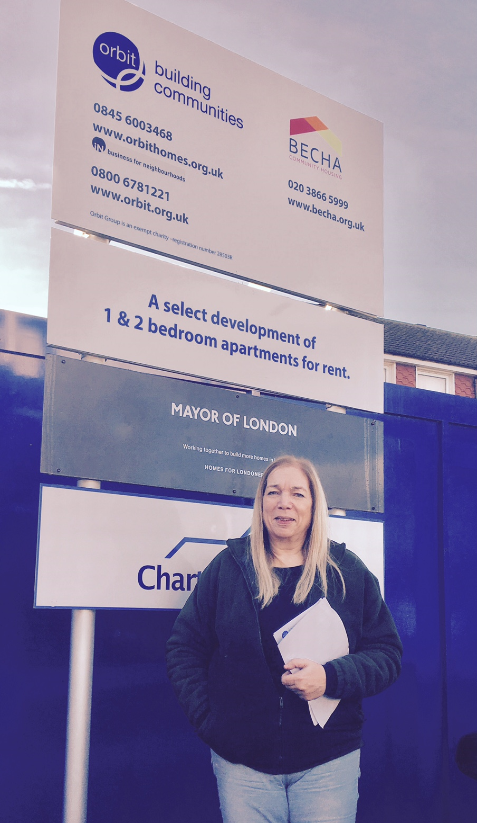


Slide 11
Bexley Community HA
“The obstacles to growth are not insurmountable”
Based in Bexley and Erith, BECHA owns 130 street properties, and manages 63 almshouses
They are currently partnering with Orbit to build 12 properties on a site which was too small for Orbit
BECHA’s board were conscious they did not want to develop at the detriment to their existing tenants, so their principle is to commit to invest in their existing properties before building new properties
Their aim is to develop 5 properties a year, funded by grant and disposals
Grant with lower rents provides less income over 40 years but more certainty on cash flow, as less is borrowed at the outset – key for a small HA
Funding was a potential barrier but opting for smaller banks was fruitful. Painstaking analysis of the risks and ensuring the right mitigation is key

Slide 12
Contact
www.g320.org.uk/our-members
Membership fees range from £25 per annum for members with less than 50 units to £100 if less than 1000 units
Clare.Norton@peterbedford.org.uk

