Slide 1
Active asset management & stock rationalisation
Mervyn Jones - Savills

Slide 2
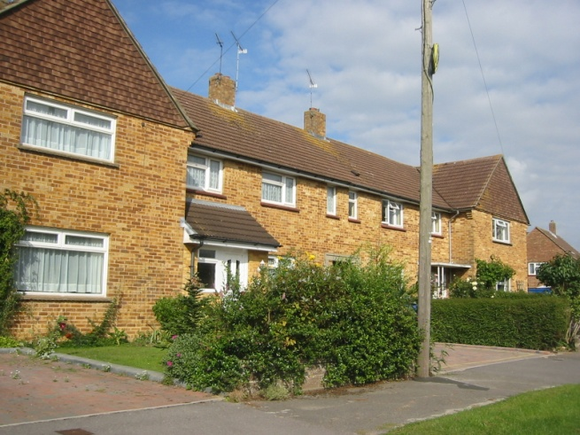
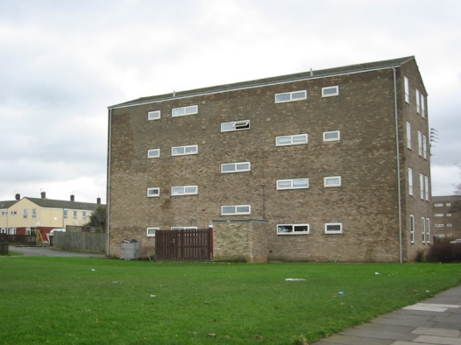
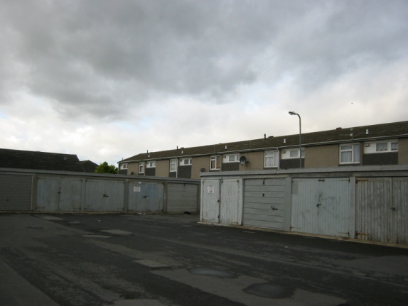
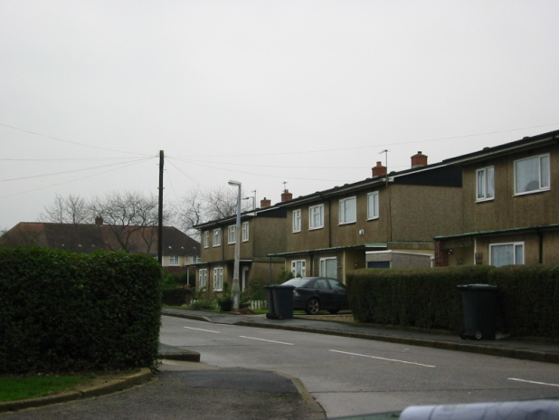
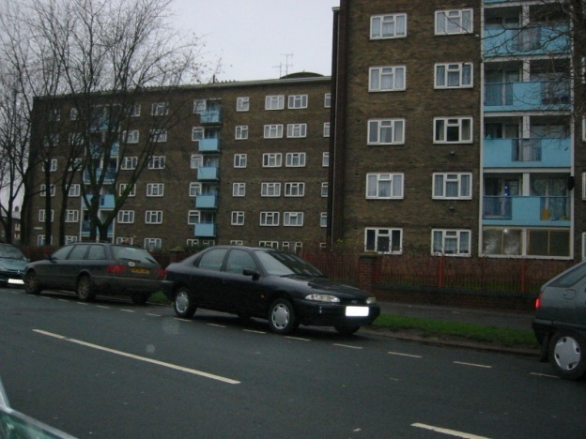
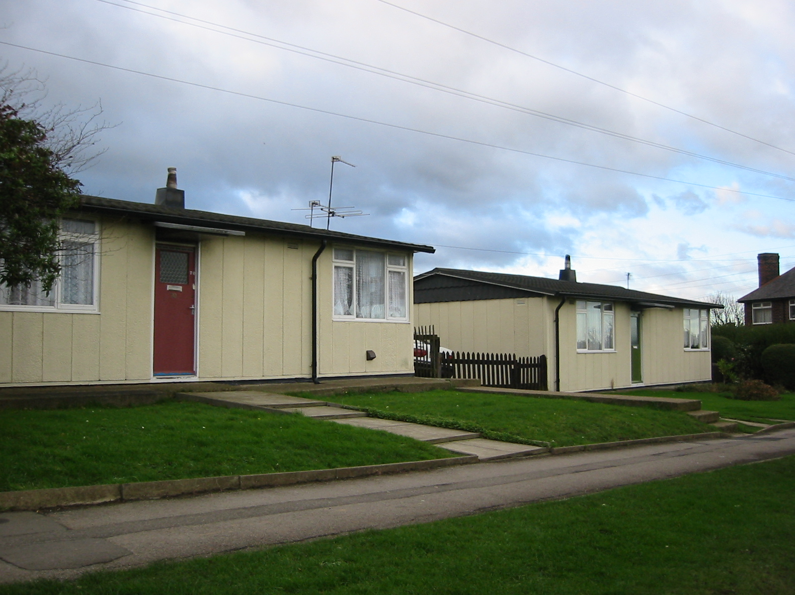
Do all properties make an equal contribution?

Slide 3
Understanding the performance of your assets
“It is as important for smaller associations to appraise their asset holdings properly and manage them effectively – including, where appropriate, rationalising stock – as for larger associations.” pp24
Measure the long term performance of your property portfolio
Identifies properties requiring an option appraisal

Slide 4
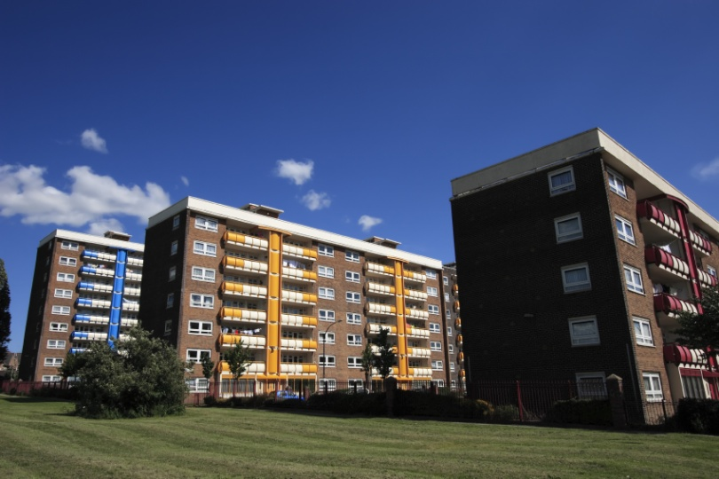
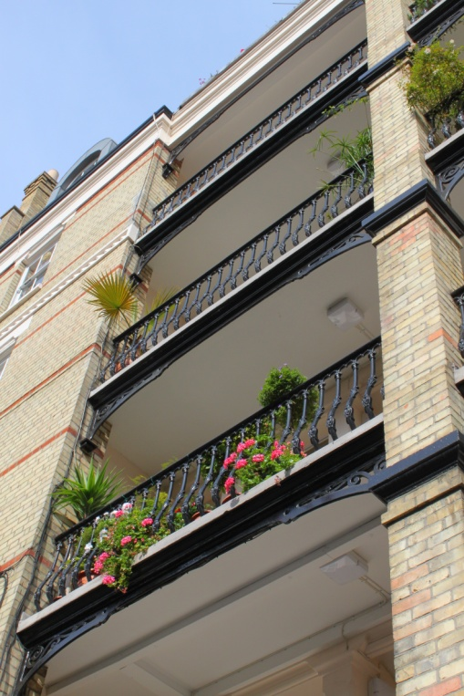
Active Asset Management
Helps plan for replacement or modernisation of properties
Make better use of capital
Integrate business planning and asset planning
Assets are not uniform
Challenge the notion of unchanging asset ownership

Slide 5
How do we measure performance and worth?
Group similar properties - Asset Groups
Separate analysis for non housing assets
Assemble data - agree assumptions
Generate cash flows
Review outputs- sense check
Agree candidate list of poor performers and understand performance drivers
Agree next steps – e.g.
Run scenarios
Prepare position statement
Asset Management Strategy
Programme of Options Appraisals

Slide 6
Results and decisions
OPTION
APPRAISAL
RECOVERY AND IMPROVEMENT PLAN
OK TO INVEST OPTIMISE PROCUREMENT

Slide 7
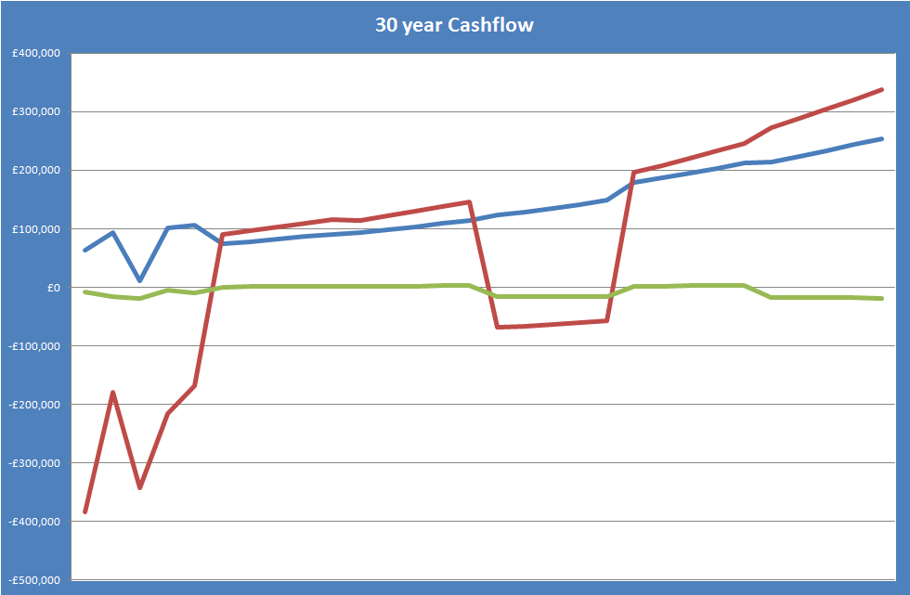
Net cash flow per annum Example of different groups of properties

Slide 8
Output Area Profiles: Future Values

Slide 9
Not all about the money – social returns
Source: Savills APE model

Slide 10
Presentation of results - 30 yr NPV in GIS

Slide 11
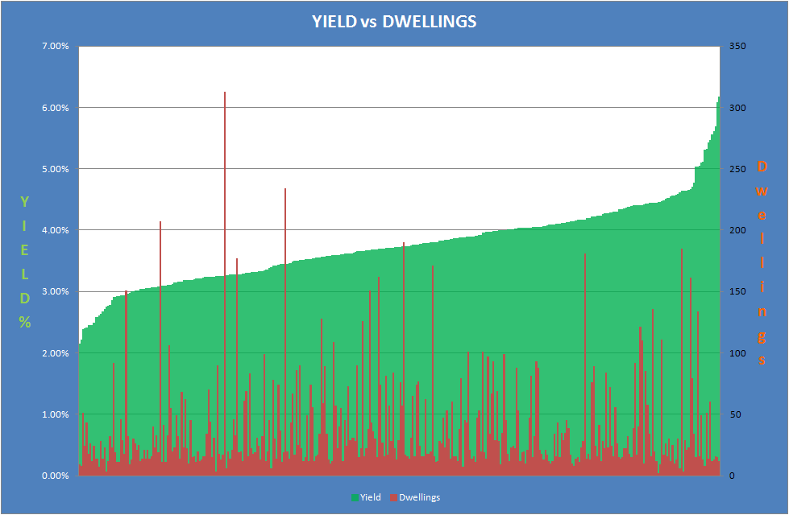
Additional analysis - yield
Green = yield measured by annual gross income / vp value
Red = the number of properties at each yield value

Slide 12
Additional analysis – Underlying asset value

Slide 13
Using asset performance to set decision framework
Something for something
At each letting – series of decisions
Preparing for conversions and considering disposal strategies – avoiding delay and maximising value at each letting
Flagging/traffic lighting in operations systems
Asset registers
Key missing information – legal and political constraints on action
Asset Group | Units | NPV | Soc rent | Aff rent | T/O | Yield | OMV
A | 9 | -£4,051 | £67.04 | £170.98 | 0.00 | 2.15% | £166,303
B | 24 | -£3,412 | £50.43 | £149.70 | 0.00 | 2.03% | £128,866
C | 8 | -£1,935 | £51.28 | £157.78 | 0.07 | 2.22% | £123,800
D | 89 | -£1,415 | £88.50 | £149.70 | 0.23 | 3.57% | £128,866
E | 28 | £414 | £92.02 | £149.70 | 0.31 | 3.71% | £128,866
F | 7 | £1,264 | £64.79 | £149.70 | 0.22 | 2.61% | £128,866
G | 3 | £2,357 | £68.26 | £149.70 | 0.67 | 2.75% | £128,866
H | 11 | £2,806 | £69.22 | £109.23 | 0.08 | 4.16% | £94,300
I | 31 | £2,856 | £67.70 | £128.04 | 0.27 | 3.75% | £107,997
J | 26 | £4,499 | £106.57 | £149.70 | 0.37 | 4.30% | £128,866
K | 24 | £4,942 | £59.54 | £149.70 | 0.23 | 2.40% | £128,866
L | 15 | £6,782 | £107.62 | £149.70 | 2.29 | 4.34% | £128,866
Source: Example from other RP’s use of asset model

Slide 14
So what? – active asset management strategy
Strengthen business plan
Make more efficient use of capital resources available
Consider long-term planning for obsolescence
Obtain a balance between new build, remodelling & stock investment
Test alternative strategies
Enable balanced investment decisions and support difficult decision making
Communicate reasons to members, staff and residents
Assist the organisation in delivering its social, financial and housing objectives
Notes:
14

Slide 15
Case study – Circle Housing Group
Asset performance evaluation as part of strategy to “Optimise value through assets”
Over 50,000 homes across 9 RP partners
Data collection and cleansing from multiple sources – data improvement plan now in place
Support streamlined decision making and coherent strategy within complex group structure
Identify group wide benchmarks for performance improvement
Market Value
NPV

Slide 16
Case study – Southampton Council
Asset performance evaluation linked to regeneration strategy
Six estates identified for social/economic reasons
Asset performance evaluated to identify land assembly and phasing options
Supporting partnership working with RPs and developers combined with direct Council delivery

Slide 17
Why Rationalise Your Stock?
“As associations become more sophisticated in analysing the contribution of their stock to their overall business, rationalising stock increasingly involves selling smaller tranches of properties.” pp29
PEST
The Political case
The Economic case
The Social case
The Strategic case
Leads to.....

Slide 18
Footprint Disposals

Slide 19
Selection of Candidates for Footprint Transfer
Selection relies on analysis at local authority level
Density of holdings - Lead/Influence/Follow/Exit model
Changing demand for a product eg
Sheltered housing
Supported housing
Tenant Satisfaction
Contribution to neighbourhood sustainability
Financial imperatives measured by NPV or worth
Relative efficiency
Development opportunities and likelihood of capital funding
Develop a customised “Priority Index” to combine these factors with appropriate weightings
Check against Business Plan/Accounts/ Budgets
Three tests

Slide 20
Density of Holdings

Slide 21
Priority Index - Sustainability
Financial and “Other” Criteria mapped
Patterns established
Allows debate and decision-making at SMT level
Conclusions on footprint:
Retain
Exit
Option Appraisal

Slide 22
Stock rationalisation lot sizes
“Most portfolios are ‘lotted’ on a local authority basis, giving small associations a chance to bid.” pp29
We have transferred over 200 Lots
Average Lot size: 72 units
Range of Lot sizes: 1 – 530 properties
Average Lot Price: £3.7m
Small enough for most active RPs
Range of Lot prices: £50k to £43.5m

Slide 23
Example of lotting – Marketing Website

Slide 24
Swaps
Increasing in number where: -
There are few potential bidders
Reinvestment in new stock will take time
Not possible to reduce central overheads to match the disposal, leading to revenue losses
Short-term impact on the Business Plan
short term deterioration in surpluses after the initial receipt, interest cover and asset cover, which may risk getting close to covenants
Difficulty finding alternative security and high price to repayment of historic borrowings at very low interest rates

Slide 25
Swaps
Obstacles
Different values!
Different quality of information
No pressure to complete
No choice for tenants
So needs a slightly different approach
Example – Genesis and Christian Action Enfield

Slide 26
Stock rationalisation by numbers
Tenure Type | Total units
Commercial | 1
General Needs | 8041
Mixed Lots | 5653
Housing for Older People | 107
Shared Ownership | 336
Sheltered | 811
Supported | 272
Intermediate Rent / Key Worker | 162
Grand Total | 15383
Notes:
26

Slide 27
Where have the bids come in compared to our EUV-SH pricing? Bid range.

Slide 28
Price by type of portfolio: totals & £ p.u.
Tenure Type | Total units | Total Bids | Bid per unit
Commercial | 1 | £ 500,000 | £ 500,000
General Needs | 8041 | £505,467,973 | £ 62,861
Mixed Lots | 5653 | £290,572,897 | £ 51,402
Housing for Older People | 107 | £ 7,003,230 | £ 65,451
Shared Ownership | 336 | £ 14,341,699 | £ 42,684
Sheltered | 811 | £ 30,320,475 | £ 37,387
Supported | 272 | £ 14,270,815 | £ 52,466
Intermediate Rent / Key Worker | 162 | £ 5,777,500 | £ 35,664
Grand Total | 15383 | £869,158,089 | £ 56,501
Notes:
28

Slide 29
Stock Rationalisation for Small Associations
“Many smaller associations have already benefited from acquiring stock from larger associations and are in a good position to market themselves to benefit further.” pp29
Bournemouth Churches Buckinghamshire Christian Action Enfield Croydon Churches Elim Greenoak Hull Churches Innisfree Inquilab | Keniston Lambeth & Southwark Mount Green Society of St James Soho Suffolk Housing United HA/BCHT York

Slide 30
Relationships with For Profit RPs
For Profits “might provide a useful experiment in increasing the capacity and productivity of the sector through equity-funded small organisations.” p27
Friendly Competitors?
Developers wanting to develop the affordable element themselves
Or
Eat my lunch and then eat me too?
Managers wanting to sweat assets

Slide 31
And finally ... the urge to merge
“The idea that there should be major merger activity among smaller associations seems fanciful” pp22
The affordable rent framework
Welfare and tenure reform
Cuts to other forms of funding e.g. support
Creating a larger asset base
Driving out further savings
Diversification into other activity to support new home development
Competition and profile
But ..... are smalls attractive morsels?

Slide 32
Contact details
Mervyn Jones
mejones@savills.com
07973 294560

