Slide 1
Mandy Elliott
Chair of NHF smaller HA forum
Member of proactive regional group of small HA in the NW
CEO of a small HA 410 homes

Slide 2
Objectives for the Group December 12
It is recognised that to add value, the group needs to have some clear overarching objectives. These are:
To provide an effective two-way communication channel with the Federation nationally to ensure smaller associations’ views are taken account of and that they are aware of Federation activity
To act as a catalyst for raising the standards of smaller associations, encouraging collaboration and sharing good practice

Slide 3
Objectives for the Group May 2014
helps to promote the work that smaller HAs do
acts as a forum to share knowledge and innovative practice.
supports the Federation to: Develop and test new policy ideas
Ensure that we see every new issue through the critical lens of smaller associations
Engage our wider membership in these debates Inform our responses to government and other key stakeholders
deadline is Wednesday 4 June at 5pm

Slide 4
NHF Smaller Associations National Group Survey of smaller housing associations 2013

Slide 5
74% of respondents were aware that there is a NHF Smaller Associations National Group
43% feel that the best way to make their views known and influence the NHF's campaigning work is through the NHF Smaller Associations National Group.
31% think the best way is through a regional forum
26% by going direct to NHF staff.

Slide 6
Priorities

Slide 7
Todays session great step towards addressing the development priority Acuity working with many of us to improve performance through benchmarking workshops and training in key areas such as VFM

Slide 8
Next Steps Today we collaborated to consider development in some depth Next we need to take control to: Work collaboratively and smartly to deliver and stop the myths around our performance, development capacity, appetite Prove our value

Slide 9
Next Steps What next – Where do we go from here? Can we do more to promote our value? Ambition to Deliver – Are we signing up?

Slide 10
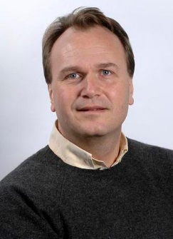
Food for thought !!!!!!
CEO Dixons talking last week about merger with Carphone Warehouse
Previously CW were considering merger with Best Buy
When asked to comment on this he said
Best Buy came along and we parked our tanks on their lawn and saw them off
Sebastian James

Slide 11
THANK YOU - everyone & special thanks to our hosts to our support service

