Slide 2
Presentation by Julia Histon Chief Executive for In Small Supply – National Event for Smaller Housing Providers
22 May 2014

Slide 3
Facts and Figures
Traditional Housing Association
Established in 1964
939 homes, owned and managed as at 31.3.14
99 of which managed for others
Stock: Yorkshire and Humber
81% in City of York
11% Leeds
4% Scarborough
4% neighbouring LA areas.
One third supported housing, including homeless accommodation
Turnover £5m

Slide 4
The Culture
Passionate about growth
Strong Board experience of development
Quality of both properties and services
High customer satisfaction
Historically risk averse: guardians of existing homes and tenants!
Want to make our contribution to the UK housing crisis

Slide 5
YHA’s Ambition
2010 – 2015 developed 270 homes i.e. increased stock by one third.
2015 – 2017 continue to develop at 40 units per annum.
Growth ‘CV’ now includes: S106, acquisition of existing social housing, new build development, purchase and repair, sales of assets, Transfer of Engagements, shared ownership.

Slide 6
The implications
Gearing rises
Test our risk appetite?
Increased financial modelling – what if?
Explore new sources of finance
Where and what to develop?
Really hone our strategy for growth
Notes:
We fit the typical model that Mark identified in his presentation in terms of financial capacity:
Gearing when measured as debt to gross cost of housing properties basis is 34% (sector average 35%)
Interest cover is 147% (sector average 197%) so less of an issue
Had to get more comfortable with risk around this so have invested in better financial modelling/business planning software to assist
Brixx business planning software – more scenario planning, financial modelling, providing assurance.
Broaden financial awareness – Day in the City visiting potential funders
Honed our development geography
Focussed on where we could be most successful :
where is the competition (to the South and West around Leeds),
where is there less/no competition (to the North and East of Yorkshire),
where could we make biggest impact? (e.g. Bishopthorpe)
what do we do best (small bespoke developments not large mixed tenure estates)

Slide 7
Practical lessons learned
Acquisition of existing social housing
Gearing = Loans as % grant + reserves
Historic grant rates = lower gearing rises
Loan security
General needs more acceptable than supported
Future proofing supported housing design
De-risking the development process
Notes:
Acquisition of existing homes
Doesn’t add to overall supply
Does provide good additional security
Provides additional rental income to provide more confidence around loan repayments
Security is a problem where one third of our stock is Supported and specialist housing. In the event of default, lenders may struggle to find a buyer and get the value back on these assets.
Doesn’t mean stop doing it – but demand more of commissioners on this basis and carefully consider design. Future proofing to provide assurance around future use and therefore validity as security.

Slide 8
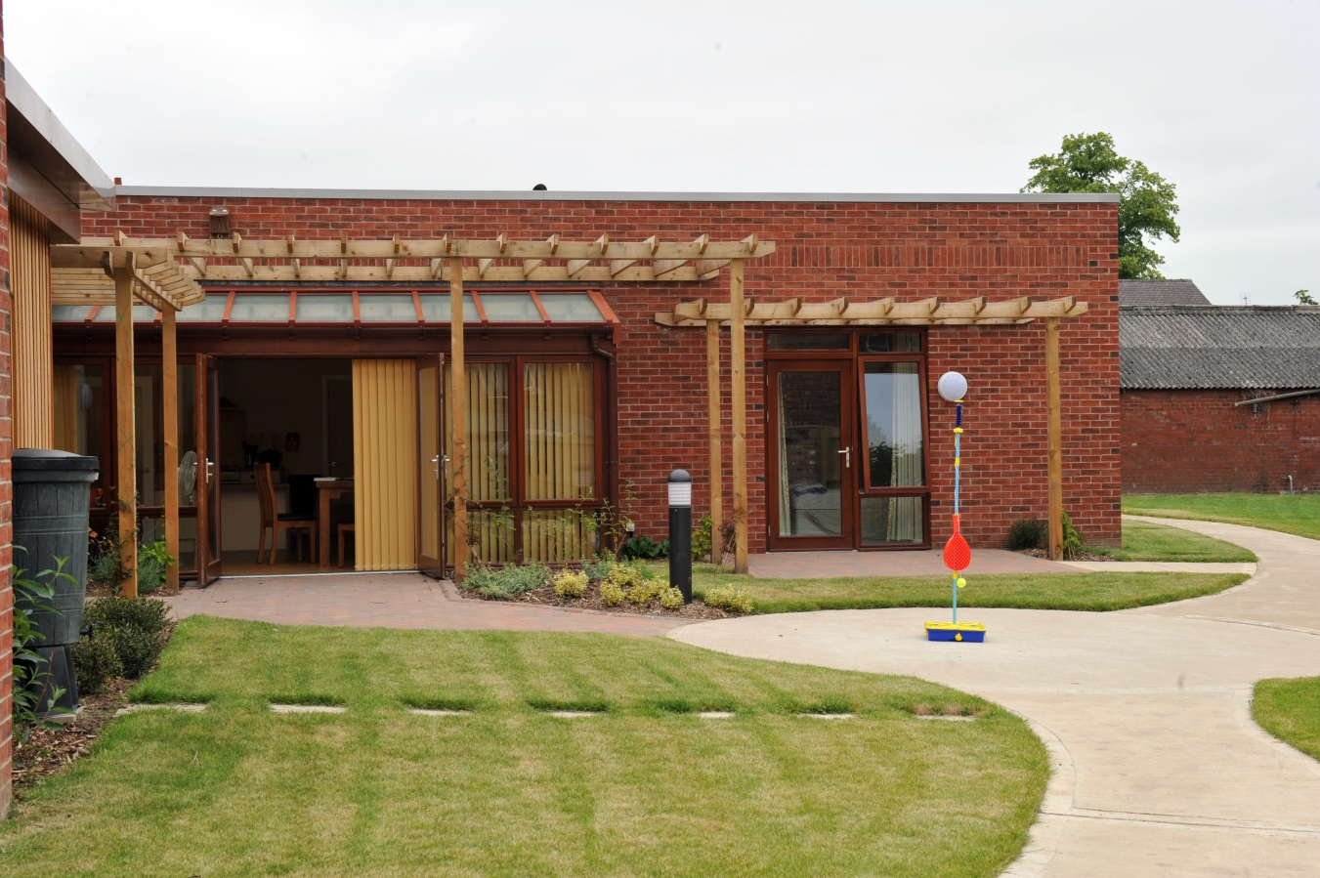
Practical lessons learned – Loan security
General needs more acceptable than supported
Future proofing supported housing design

Slide 9
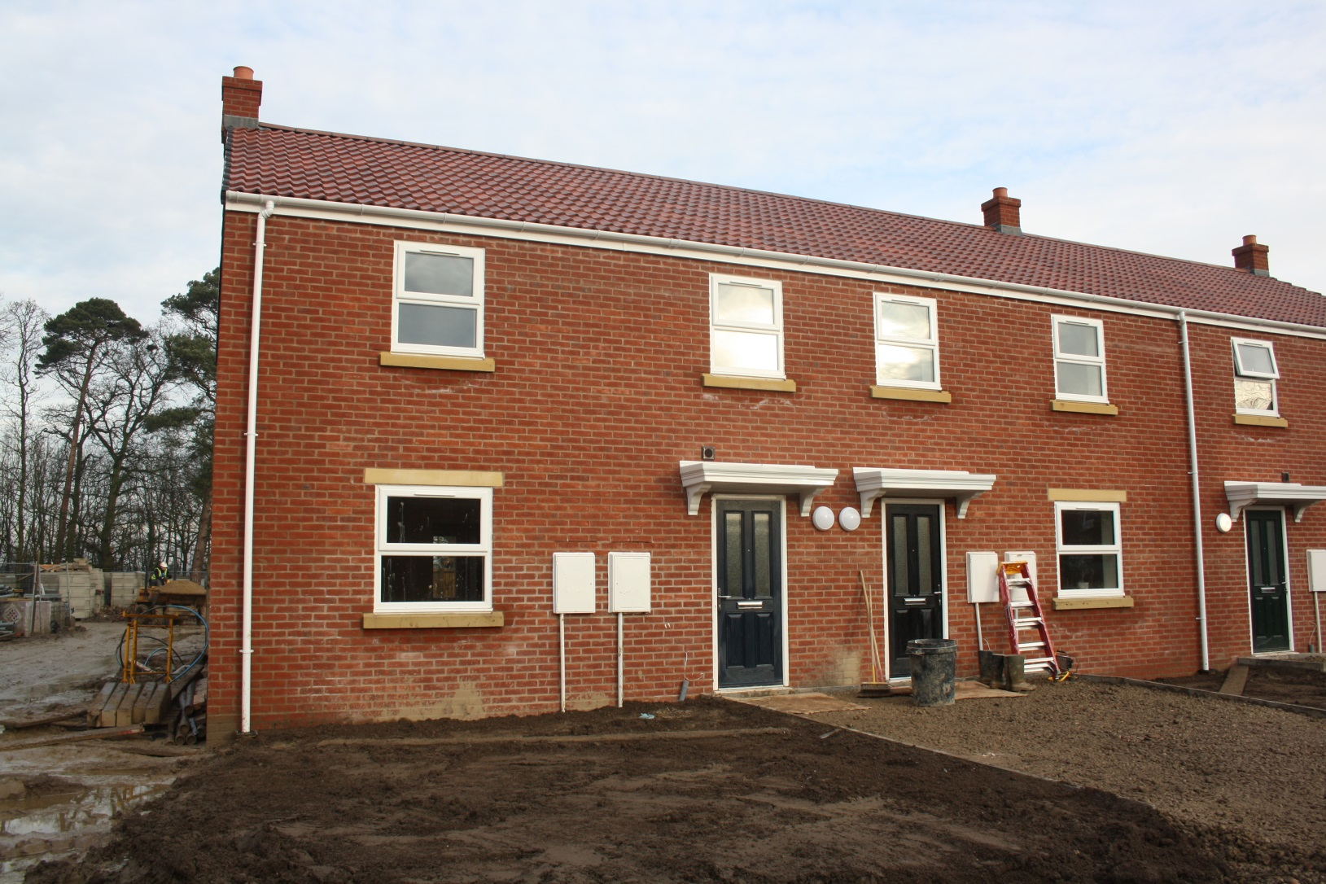
Practical lessons learned: De-risking the development process
Notes:
Design and Build
Off the shelf purchase
S106
You don’t pay unless you are happy with the end product/progress along the way.
Gives smaller HA’s more control if staff capacity is an issue
Provides Board with less risk as more control

Slide 10
Practical lessons learned – Partnering with others to build experience
Notes:
No experience of extra care housing
Lots of experience of older persons and support
Didn’t want to miss the opportunity
Where demand was from the Local Authority
Partnered with an experienced larger HA to act as lead developer on our behalf.
We now manage their stock in our area!
Don’t be afraid to use others where you don’t have the experience in-house

Slide 11
Next steps
Planning 3 – 5 years ahead:
Exploring now, what our potential future barriers will be.
Gearing ceilings and security.
Potential solutions?

